Slide 1
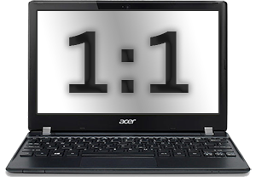
Introduction
2014-2015 School Year

Slide 2
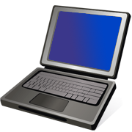
Introduction
Welcome to a new school year and the beginning of the 1:1 laptop program at Havana High School!
This tutorial will teach you how to log in to the school network, access your Google e-mail account, the online grade program, and the online curriculum.
It is very important to listen to your teacher’s instructions and follow along with this tutorial. Please do NOT work ahead or try things on your own – you will have time to explore your laptop after we are done!

Slide 3
1:1 Laptop Program
Personal electronic devices (cell phones, tablets, etc.) may be used during your lunch hour/recess
You may lose this privilege if you do not use your devices in a school appropriate manner! You SHOULD NOT take pictures of other students or post information about other students on social networks/apps!
Any incident with the computer will be investigated and the student handbook will be followed

Slide 4
Student Responsibilities
You should take good care of the laptop. It is school property and yours to use for educational purposes.
NOTE: You will be allowed to carry your laptop in a sleeve, case, or small bag (cinch sack, messenger bag, or small book bag.)
Make sure your laptop is charged each night so you will be able to use it during the school day.
NOTE: It is a good idea to let the battery run down as low as possible before charging as this will help your battery have a longer life. However, you must make sure you have enough charge to get through the school day.
You should NOT download any software or make changes to your laptop unless you have permission from your teacher.

Slide 5
If you have a problem …
1st Step … Let your teacher know if you have a problem with your laptop. Your teacher may be able to help you fix the problem.
Q
2nd Step … If your teacher cannot fix it for you and you cannot find it on the Tech Help page, have your teacher submit a QNS request. Someone will be available to help you – either in person or remotely (they will “take over” your computer)!
NOTE: All requests are tracked so we know who sends them.
N
S

Slide 6
Get your laptop & info …
Do not open the laptop or turn it on!
Please wait quietly while your teacher passes out the laptops and information slips.

Slide 7
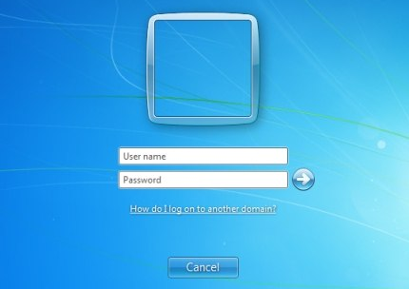
Getting started …
1st - Open your laptop and then turn it on by pressing the power button.
2nd – Enter your network log in and network password on your info slip (it is case sensitive).
2018csnowden
126S12345
If you cannot log in, wait 10-15 seconds and try again.

Slide 8
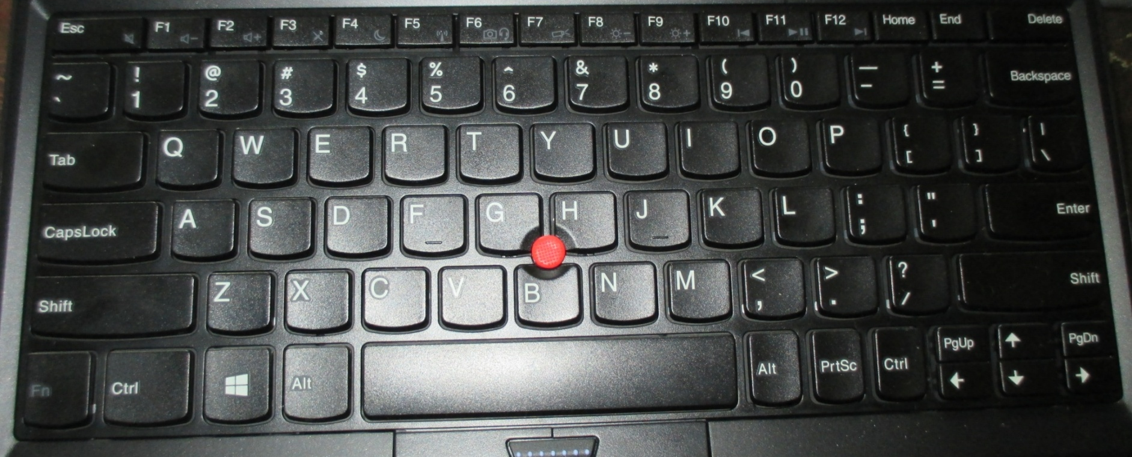
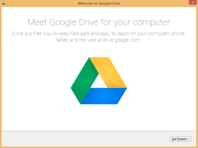
Need the screen brighter?
Hold down the FN button and press F9 to brighten your screen.
Keeping the screen dimmer will help conserve battery life! Use FN+F8 to dim your screen.
Watch for the MEET GOOGLE DRIVE window. Don’t click anything until your teacher tells you to click!

Slide 9
Need to change the volume?
Hold down the FN button and then press F1 to decrease the volume or F2 to increase the volume.
Watch for the MEET GOOGLE DRIVE window. Don’t click anything until your teacher tells you to click!

Slide 10
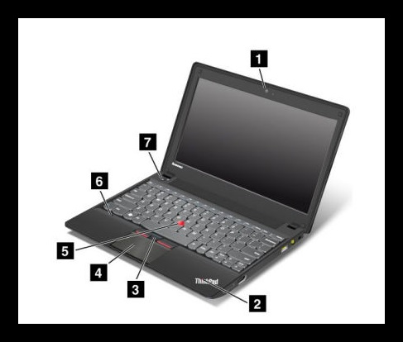
Laptop Features
1 – Camera
2 – System status indicator
3 – TrackPoint buttons
4 – Touch pad
5 – TrackPoint pointing stick
6 – Microphones
7 – Power button

Slide 11
Logging Off
You should log off whenever you are not using your laptop. Staying logged in gives anyone who uses your computer access to your files.
1 – Click the Windows button.
2 – Click the arrow beside “Shut down”, select Log off.
3 – Close your laptop. It will enter “Sleep Mode” until you are ready to use it again.
Did you know shutting down your computer uses more energy than allowing it to go to sleep?

