Slide 1
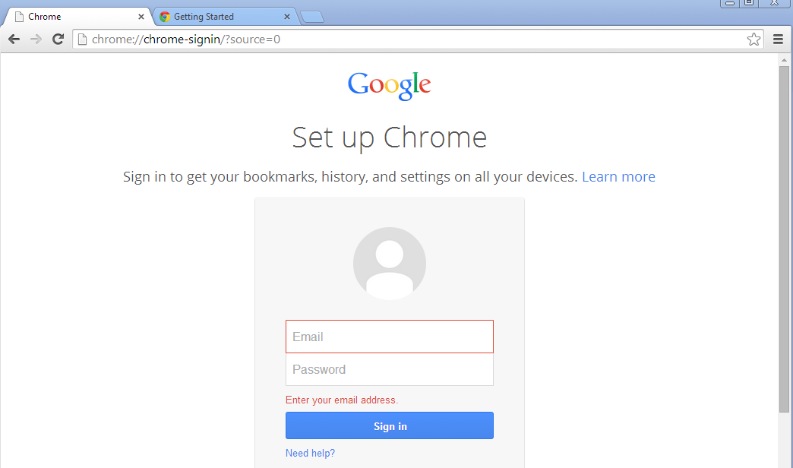
Setting Your Homepage
1st - Double-click the CHROME icon to open the browser.
2nd – You do not need to sign in.
3rd -- If you see this bar, click the SET AS DEFAULT button.

Slide 2
3rd - Enter the web address for the high school website.
4th - Click the Chrome menu button
5th - Click SETTINGS.

Slide 3
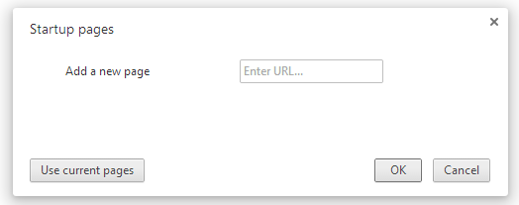
6th - Click SET PAGES
7th - Choose USE CURRENT PAGE.
8th - Click OK.

Slide 4
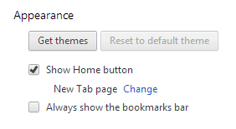
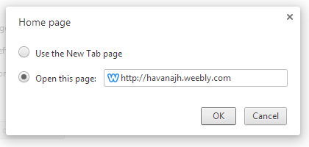
9th - Click the box in front of the SHOW HOME BUTTON.
10th – Click CHANGE.
11th - Choose OPEN THIS PAGE.
12th – Type in the high web address. Click OK.
13th – Click the X to close the Settings TAB.

