Slide 1
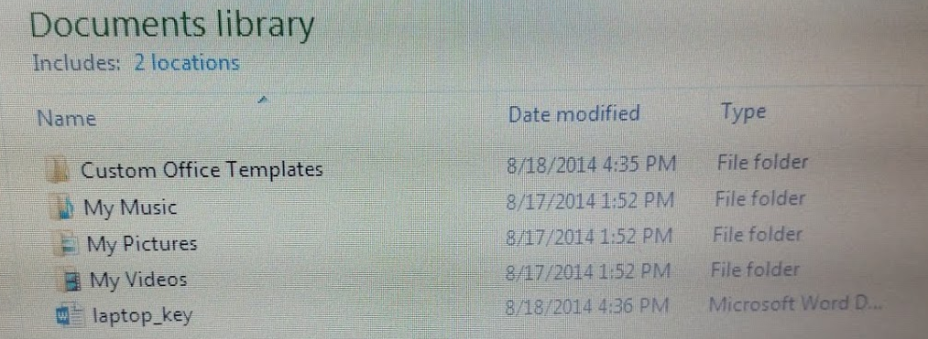
Saving to Your Flash Drive
Teachers: Handout Flash Drives. Encourage students to put names or initials on it with permanent markers.
1st Step – Open “Laptop Key” from your documents. Click the Windows button, then documents.
2nd Step – Find laptop_key in your list of documents and click twice.

Slide 2
3rd Step – Plug in your flash drive to a USB port on your laptop. (You will see a message that driver is being installed.) Wait until it is ready to use.

Slide 3
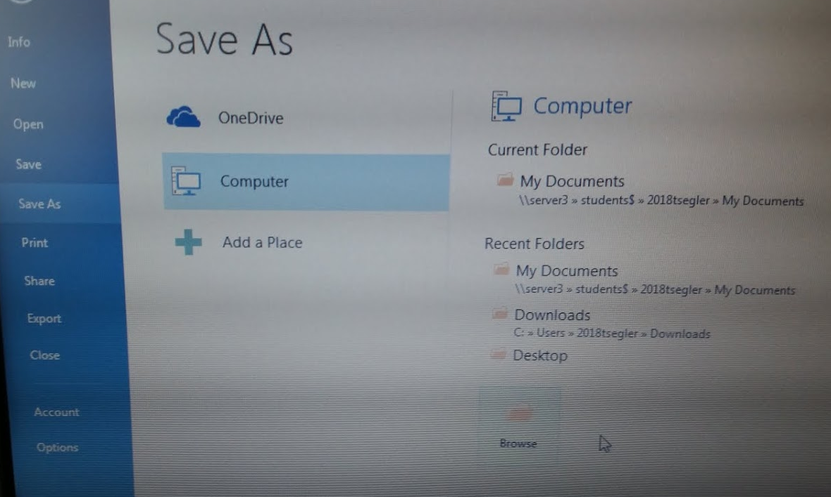
4th Step – To save a copy of laptop_key to the flash drive, click FILE, Save As, Browse.

Slide 4
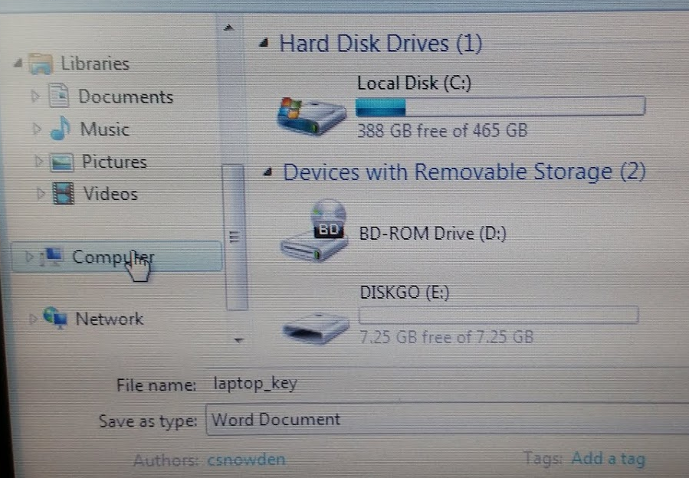
5th Step – Click Computer, Double click DISKGO, Save.

Slide 5
6th Step – Close the Word document. The file is now on your network and flash drives.
To Care for Your Flash Drive:
7th Step – On the lower right-hand corner the task bar, click the USB Symbol.
8th Step – Click Eject Mass Storage Device
9th Step – Wait for the Safe message,
Then remove your Flash Drive.

