Slide 1
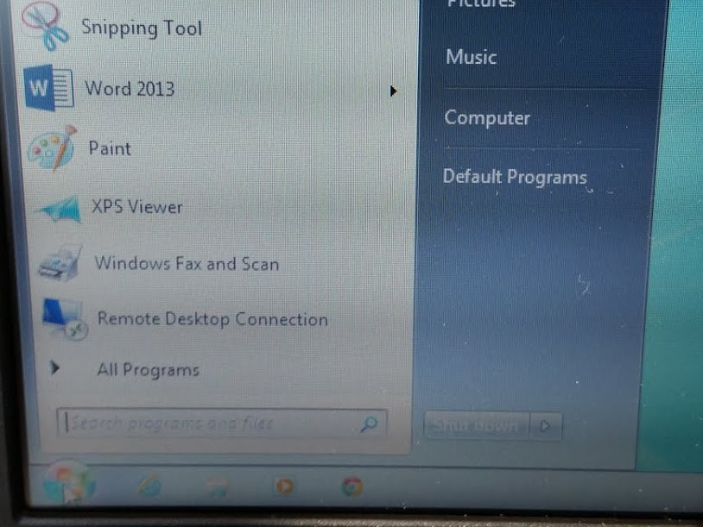
Opening a File From the Flip Server
1st Step – Click Windows button then Computer.

Slide 2
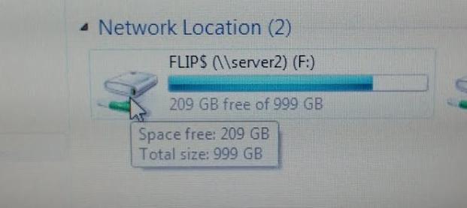
2nd Step – Click twice on the FLIP server.
3rd Step – Find HHS Technology, click twice.
4th Step – Open the Online Presence folder, click twice on the video link in the folder. Watch the video!

Slide 3
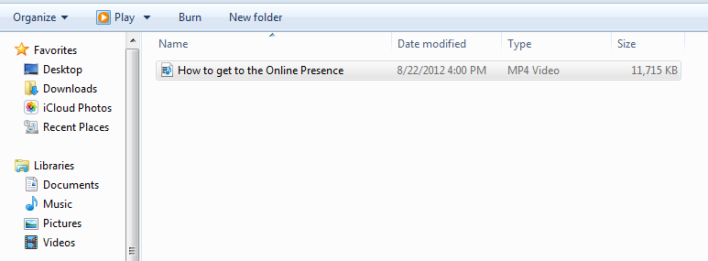
4th Step – At the end of the video, click X to close it.
5th Step – Copy the video to your network folder by clicking once on the title of the movie (it will turn blue); right-click on the touch pad, copy.
6th Step – Right-click on Documents, paste.
STAY ON THIS SCREEN FOR THE NEXT ACTIVITY!

Slide 4
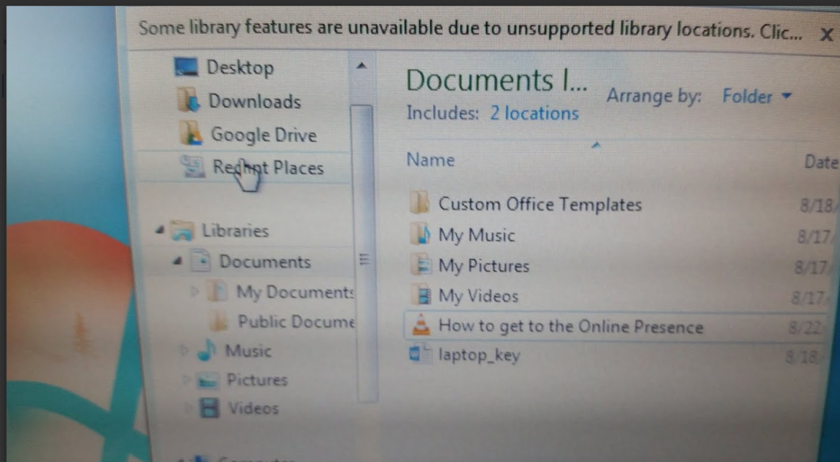
Saving to Your Google Drive
Remember: Your Google Drive is your “cloud”.
Anything you store here may be accessed
from any computer with internet capabilities.
To Save to your Google Drive from the network:
1st Step – Right click on the video and copy.
2nd Step – Right click on your Google Drive and paste.

