Slide 1
Access the Flip Folder From Home

Slide 2
Step 1:
All you have to do is put the following address ftp://www.havana126.net/ into the internet address bar. and login using your network login and password.

Slide 3
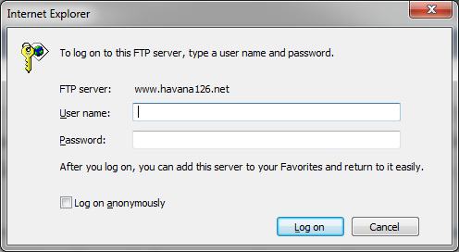
Step 2:
The Login will look like this...
Just type in your school login and password.
.

Slide 4
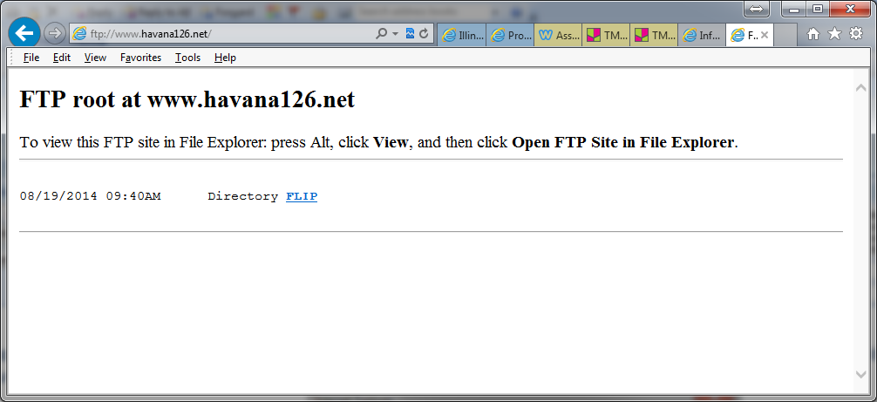
Step 3:
You will see the flip folder below…
Click on FLIP next to the word Directory.

Slide 5
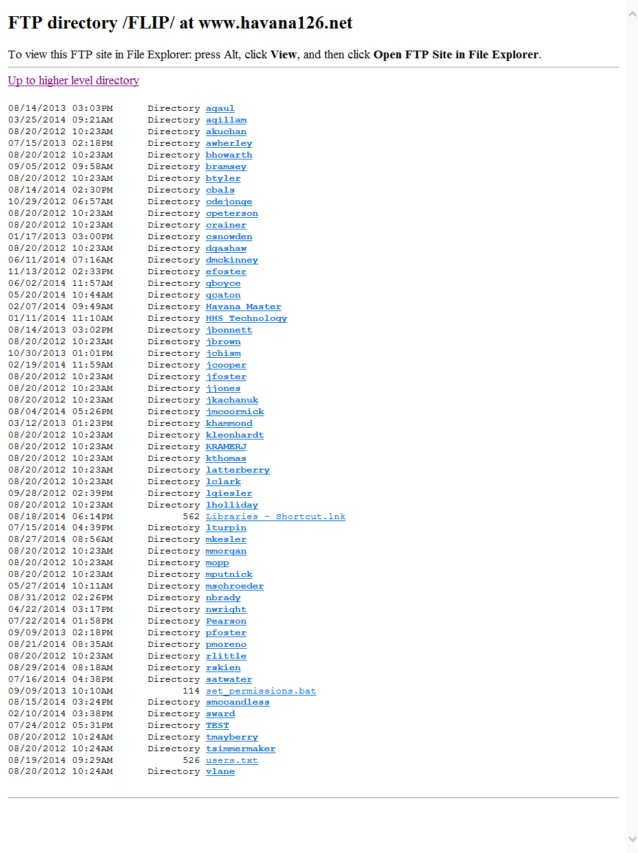
Step 4:
You will see all the teacher's folders...
Click on the teacher’s name to open his/her Flip Folder

