Slide 1
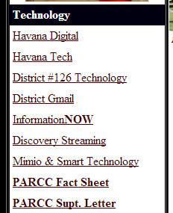
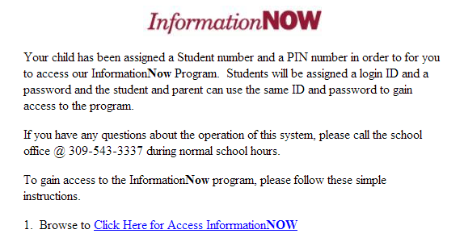
Information Now
1st – Click the home button to return to the HHS website (if you are not already there.)
2nd – Click the link for INFORMATION NOW on the high school web page then here.

Slide 2
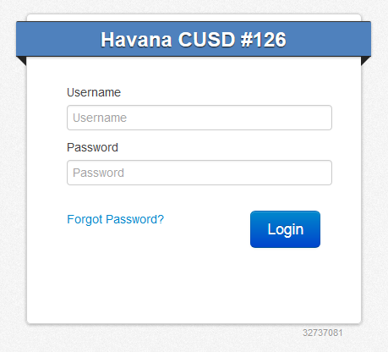
3rd – Enter your unique user name (your teacher has this information) and use ducks123 for your password.
4th - Click LOGIN.
ducks123

Slide 3
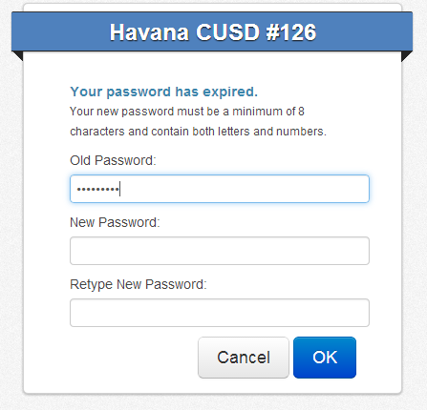
5th – Enter your second password – the “126S” number with S as a capital letter and your initials in lower case.
6th - Click OK.
ducks123
S – Capital letter
Initials – Lowercase letters
Example: 126S12345cs
Click SAVE PASSWORD anytime you see this bar.

Slide 4
7th – Click GRADES to see a list of your classes.
8th – Click one of the A buttons to see your grades for a class.
9th – Click the  next to your name (upper right-hand corner) and then choose LOGOUT.
Carla
10th – Click the X to close the INFO NOW tab.

