Slide 1
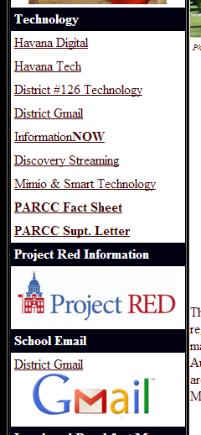
Google E-mail
1st – Go to the HHS website by clicking the Google Chrome button.
Close any extra tabs if you have more than one open.
2nd – Click either of the links for District Gmail.

Slide 2
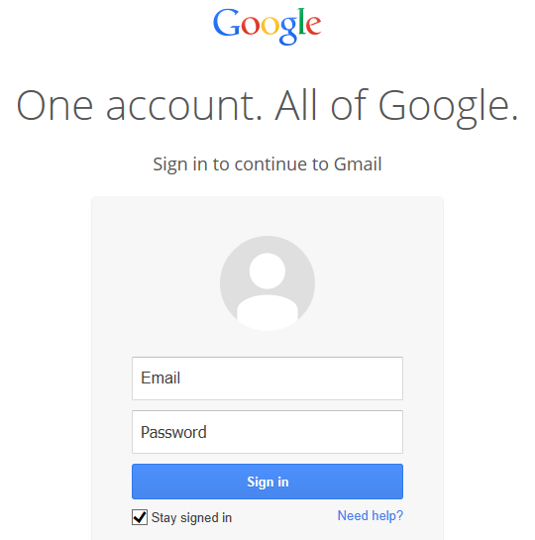
3rd – Enter your user name and new password (the one with your initials at the end).
4th - Check the box before STAY SIGNED IN and then click SIGN IN.
Click SAVE PASSWORD anytime you see this bar.

Slide 3
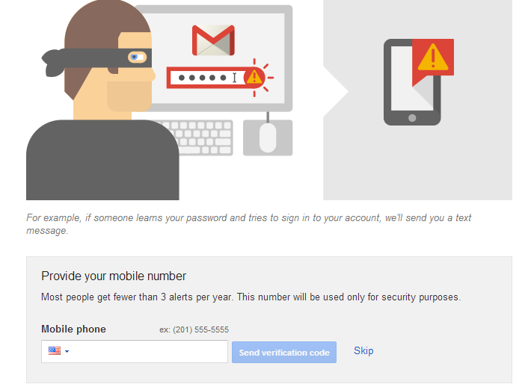
When you see this screen, click SKIP.

Slide 4
5th – Your e-mail will be visible in your INBOX.
6th – Click the GRID and then click DRIVE to view it.

Slide 5
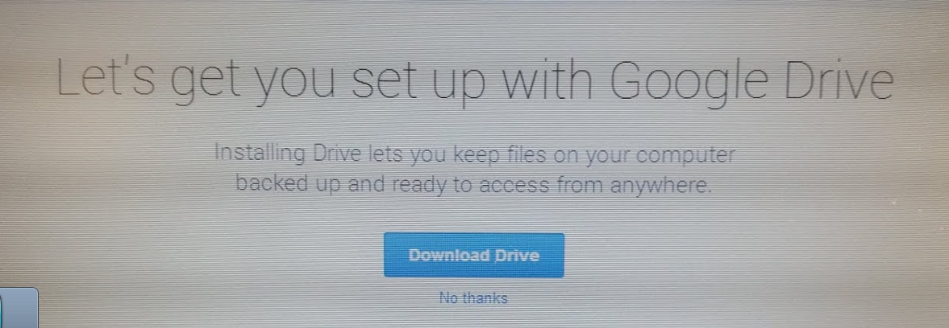
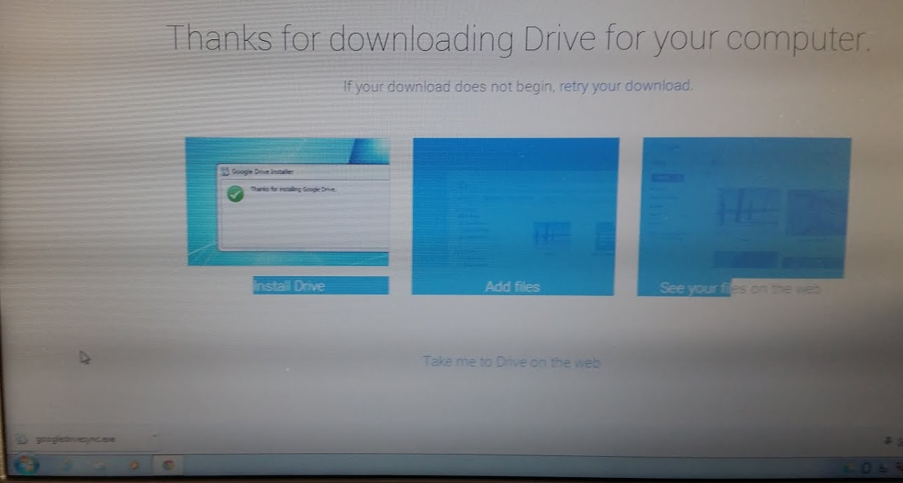
6th – Click Download Drive.
6th – Click the download at the bottom of your screen to run. (Now wait patiently.)

Slide 6
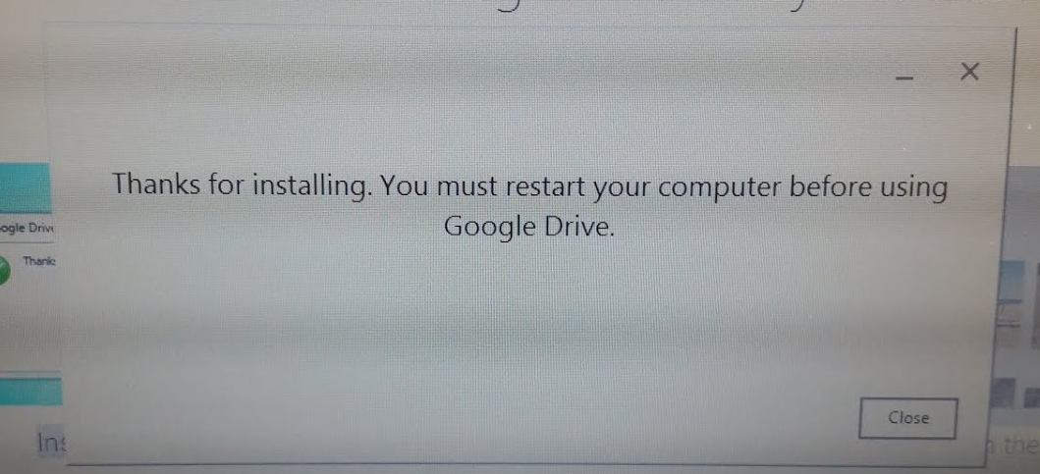
6th – Click Close on this screen. Also close extra tabs at the top of your screen to return to your inbox.

Slide 7
7th – Your e-mail will still be visible in your INBOX.
8th – Click the GRID and then click DRIVE to view it. You should now see the video from 3rd Hour.
9th – Close the Drive Tab. In your mail tab, click Compose. Send an email to your teacher. He or she will tell you what to include in the subject line and body of the email.

