Slide 1
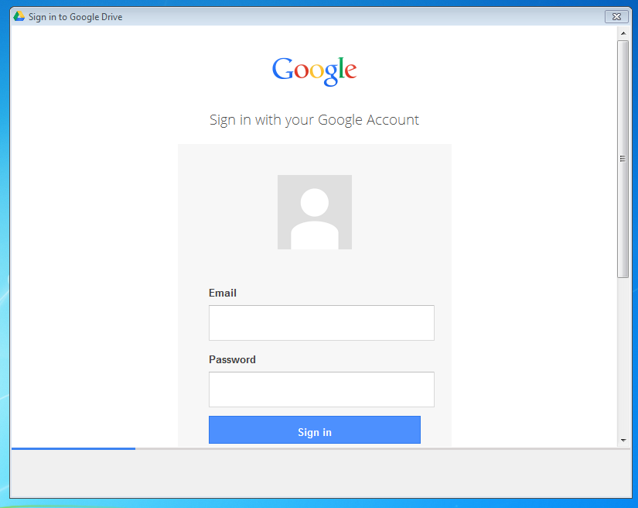
Your Google Drive Account
1st – Log in. Wait for the Google Drive window to open.

Slide 2
2nd - Enter your school e-mail user name and the email password in the Google window that appears.
2018csnowden@havana126.net
126S12345
3rd - Click SIGN IN.

Slide 3
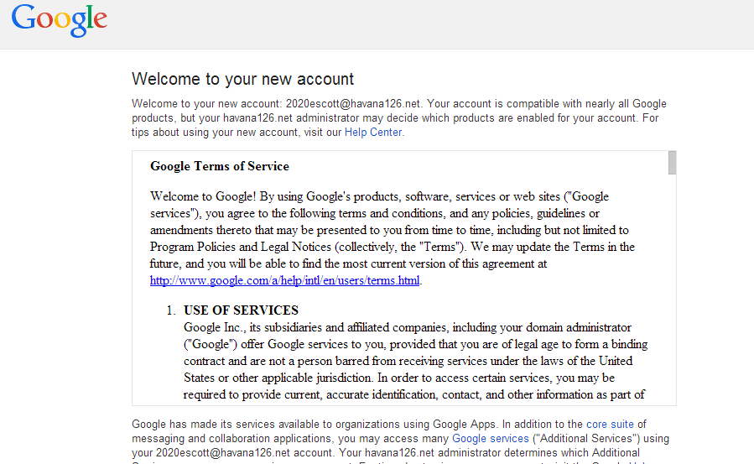
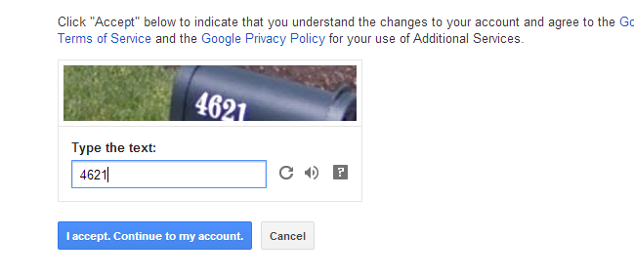
4th – Scroll down the NEW ACCOUNT information page.
5th – Enter the numbers you see.
If you don’t see any numbers, click the REFRESH icon.
6th – Click the I ACCEPT - CONTINUE TO MY ACCOUNT button.
Be patient - it may take a few seconds for the next page to load!

Slide 4
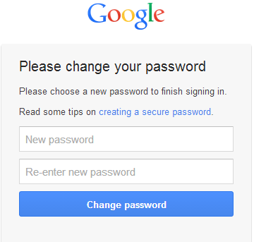
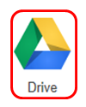
7th - Enter the second password (with initials after it) in the bottom 2 windows.
126S12345cs
S – Capital letter
Initials – Lowercase letters
Once you have signed in and closed the login window, an icon should appear in your toolbar area and on your desktop. It may take awhile for the desktop icon to appear

Slide 5
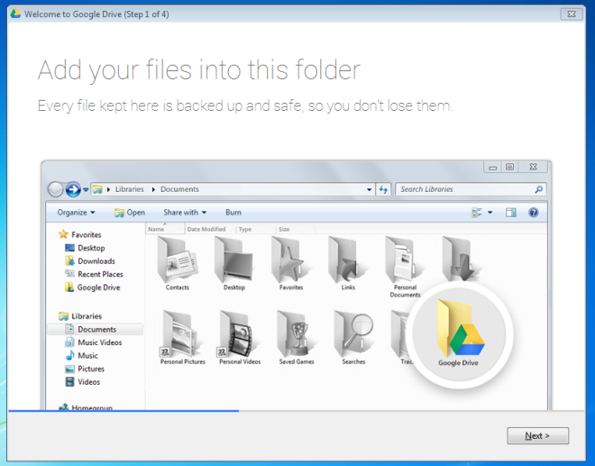
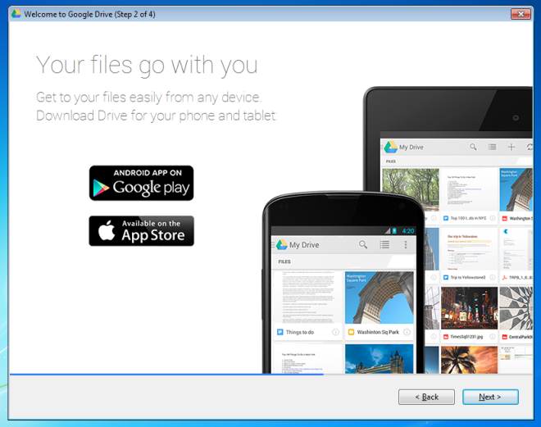
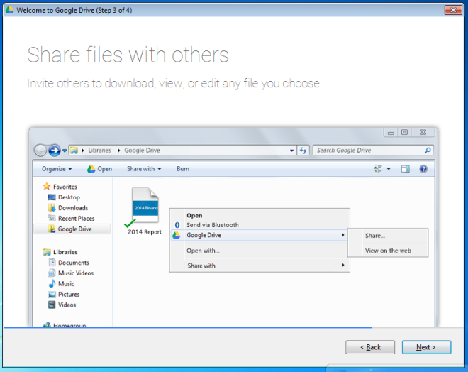
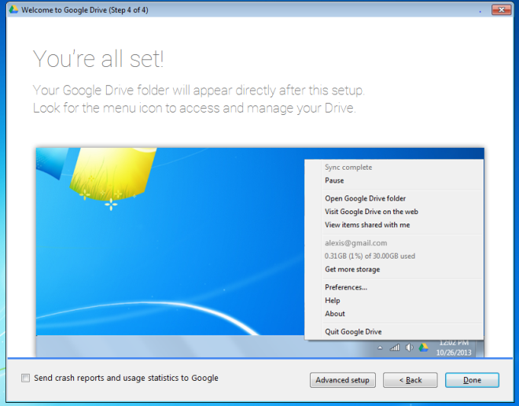
8th – Click NEXT for the next three screens and then click DONE.

Slide 6
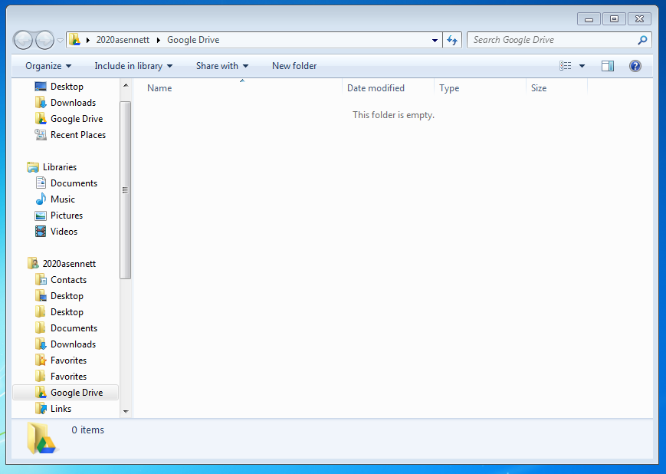
9th – A window will pop up to show you what files you have in Google Drive → You shouldn’t see anything right now, but will after you add files.
10th - An icon should appear in your toolbar area and on your desktop. It may take awhile for the desktop icon to appear. Log off.

