Slide 1
Creating Google Calendar
1st Step – Log in to your student Gmail Account.
2nd– Your e-mail will still be visible in your INBOX.

Slide 2
3rd – Click the GRID and then click Calendar.
csnowden@havana126.net

Slide 3
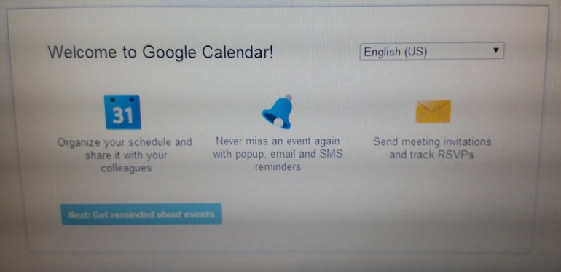
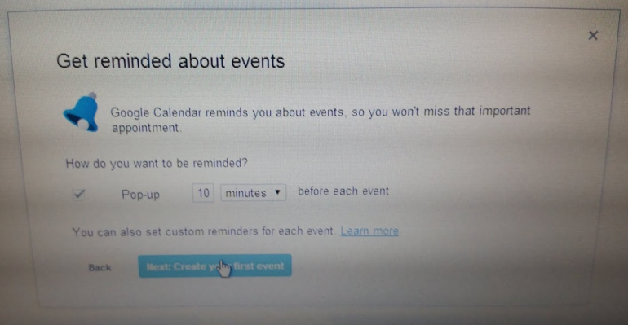
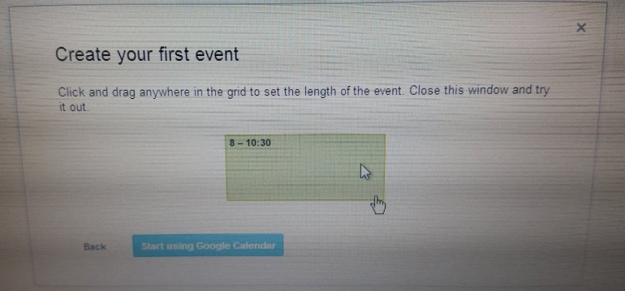
4th Step
5th Step
6th Step

Slide 4
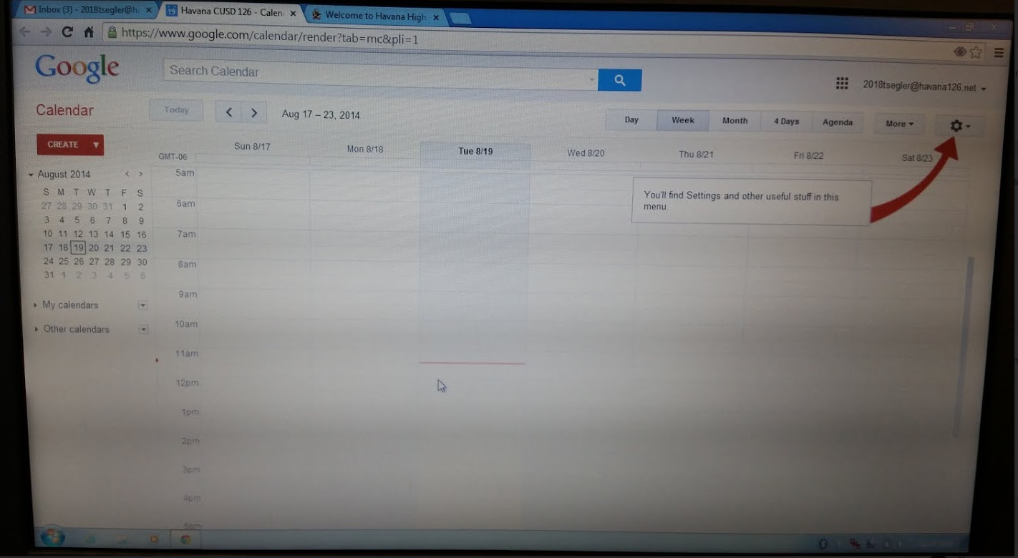
7th Step – Create a calendar. Call it “Assignment”.
8th Step – Create an
event on your
calendar.
(If you do not have an assignment for students to add, have them enter “Meet the Ducks” on Friday, August 22, 5-8 p.m.)

