Slide 1
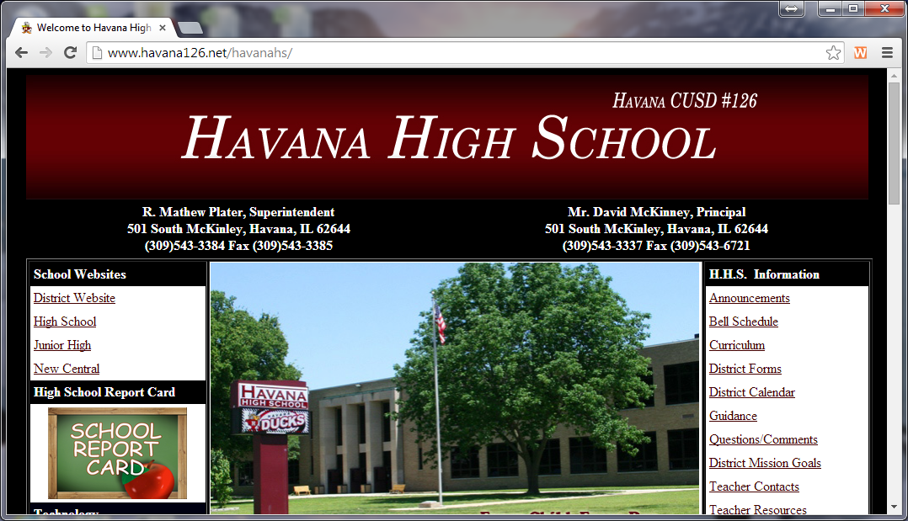
How to Change the Pop-up Setting in Chrome
Step 1—Open up a window in Chrome.
Step 2—Click on the three horizontal lines on the right side of the screen to open the drop-down menu.

Slide 2
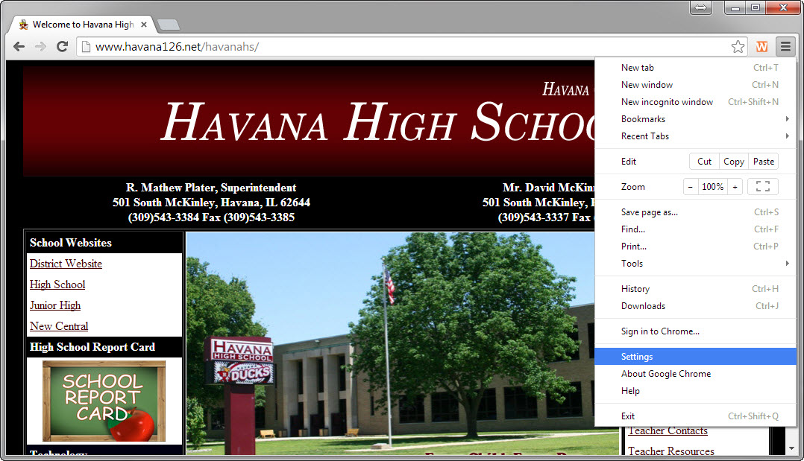
Step 3—Click on Settings.

Slide 3
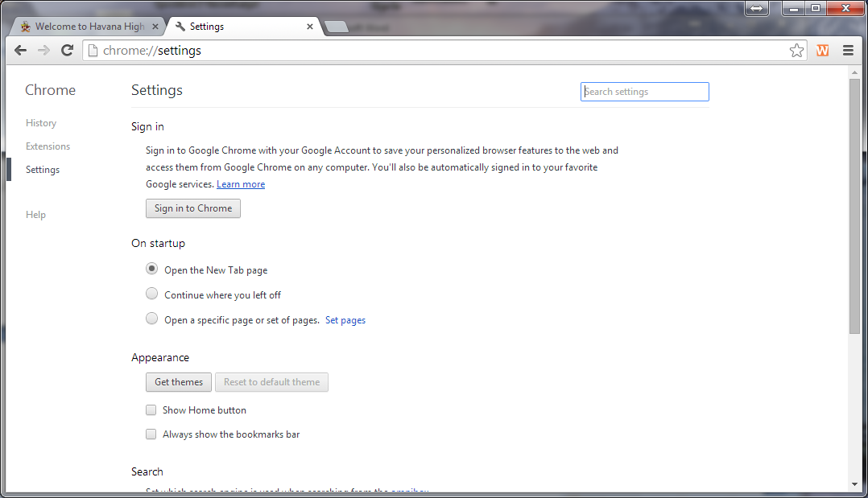
Step 4—In the search box, type the word (pop) and click enter.

Slide 4
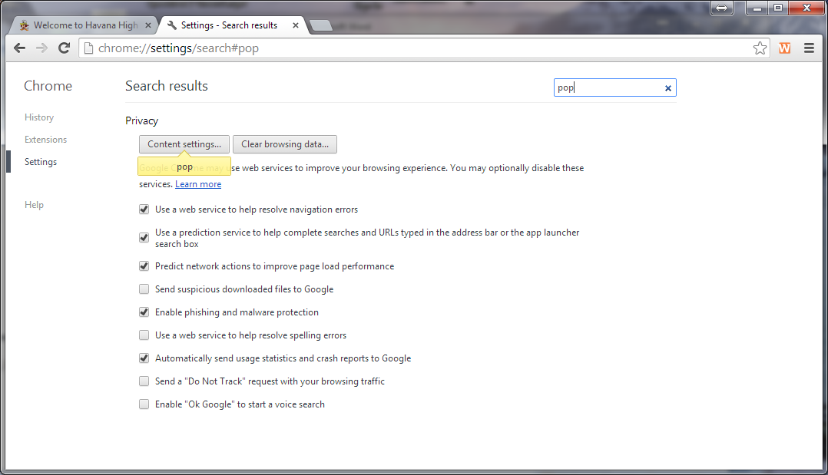
Step 5—Click on Content Settings.

Slide 5
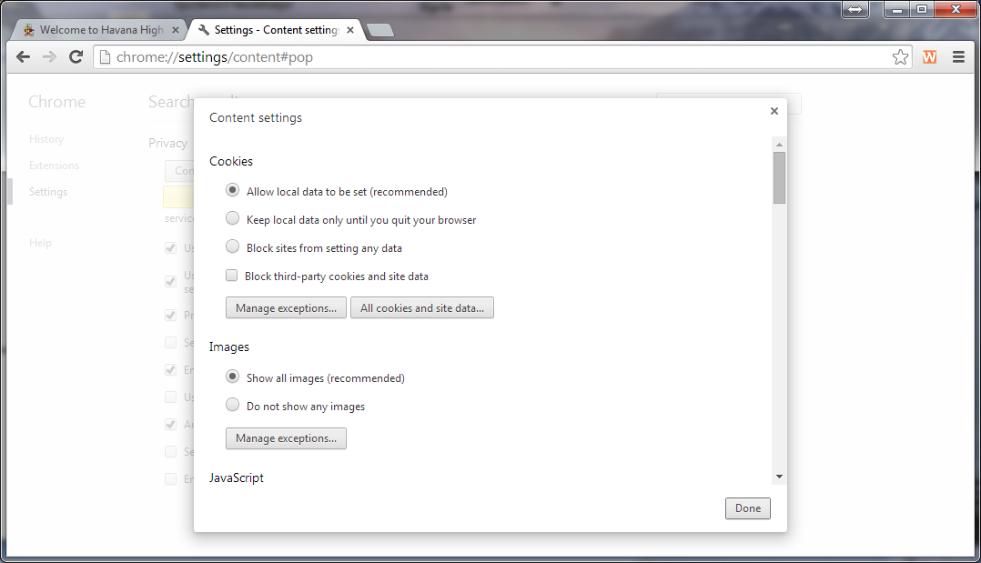
Step 6—A new window will open.

Slide 6
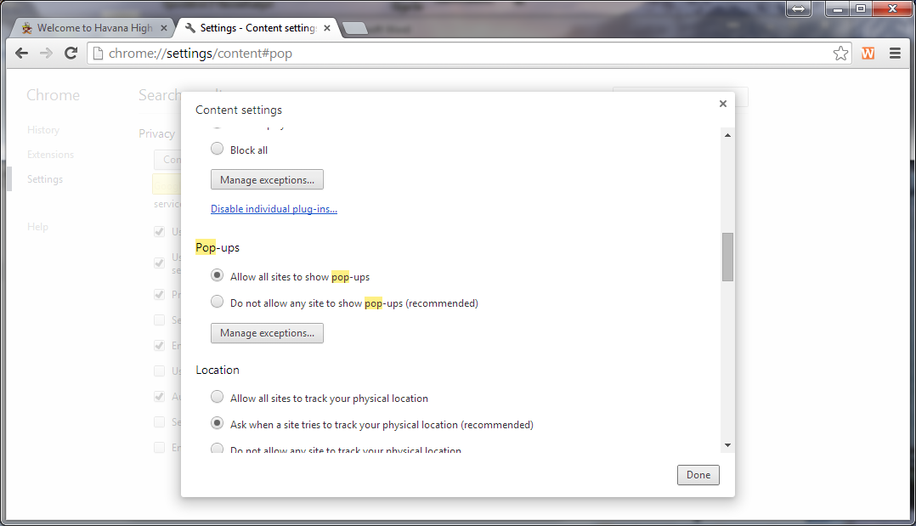
Step 7—Scroll down until you find Pop-ups, and then select (Allow all sites to show pop-ups)
Step 8—Click Done; you are finished.

